Slide 1
RA 505 Robot Sensing and Vision Lecture 29
Dr. Rishikesh Kulkarni
Department of Electronics and Electrical Engineering
IIT Guwahati

Slide 2
Ultrasonic rangefinder
Doppler Shift in Ultrasound Transmission

Slide 4
Distance between sensors
Actual distance measured
Dead zone
Detectable range

Slide 5
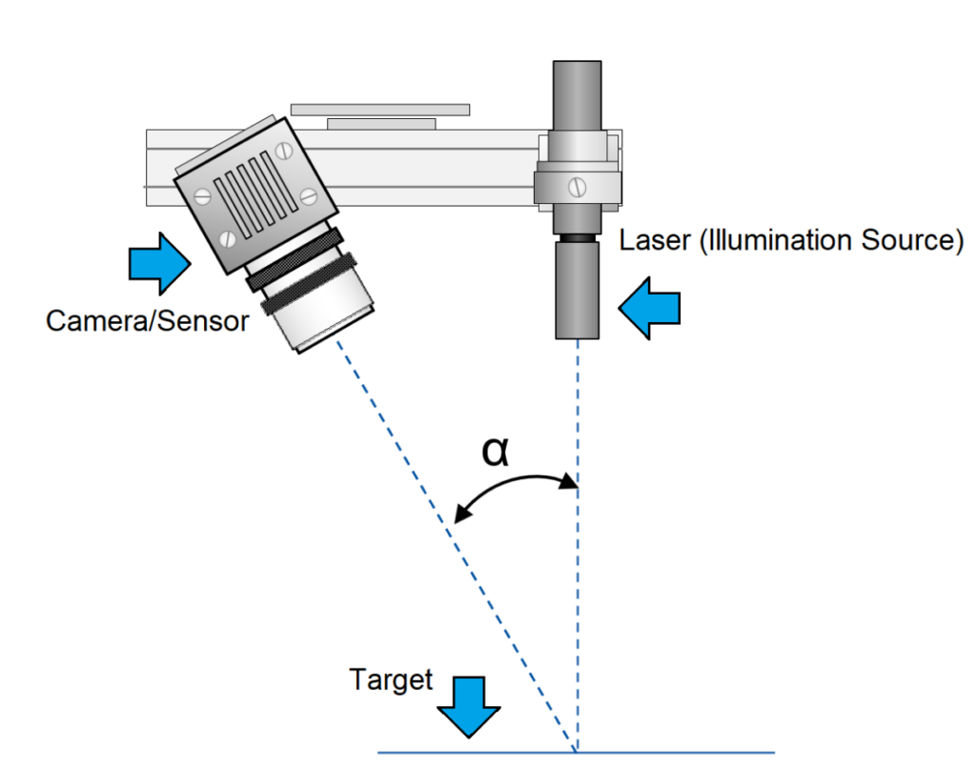
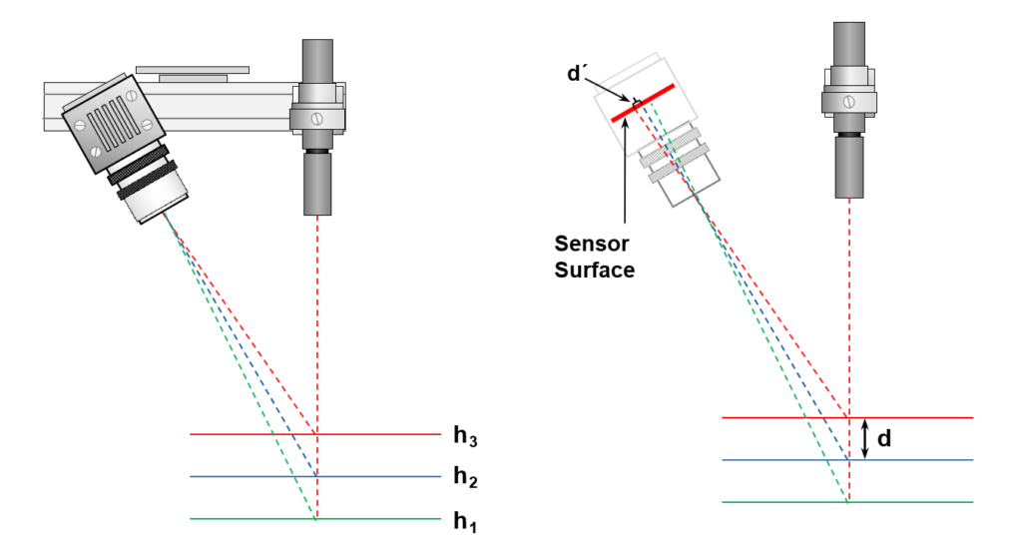
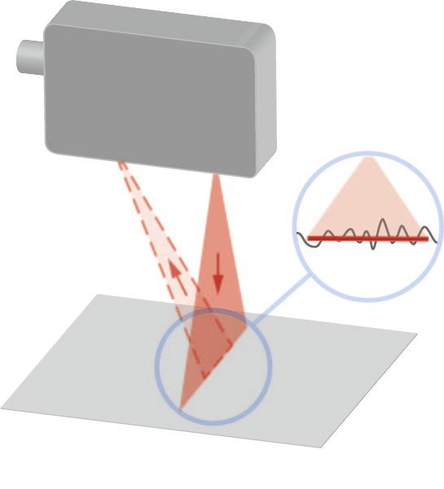
Optical rangefinder
Laser triangulation
1D, 2 ½-D and 3-D Sensors
IR sensors

Slide 6
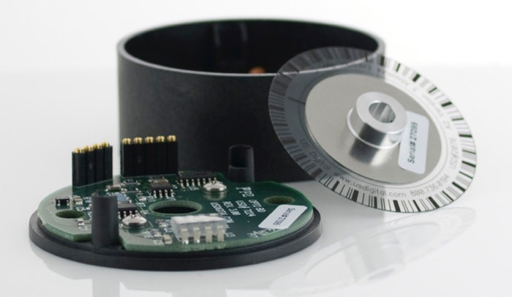
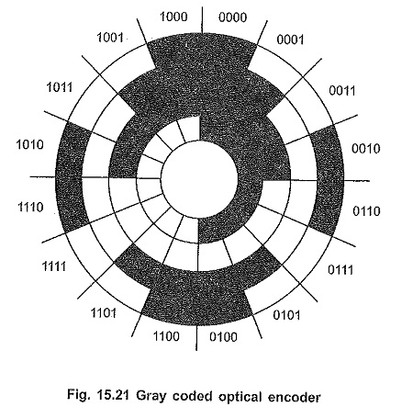
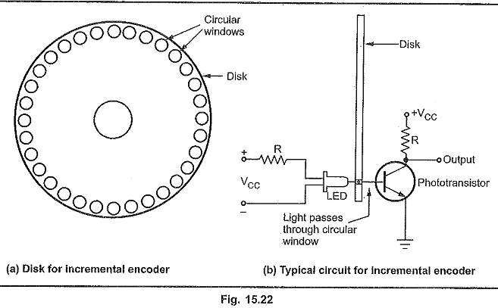
Position measurement
Optical encoder
Measurement of rotational angle
Reference grating and direction of rotation

